Slide 1
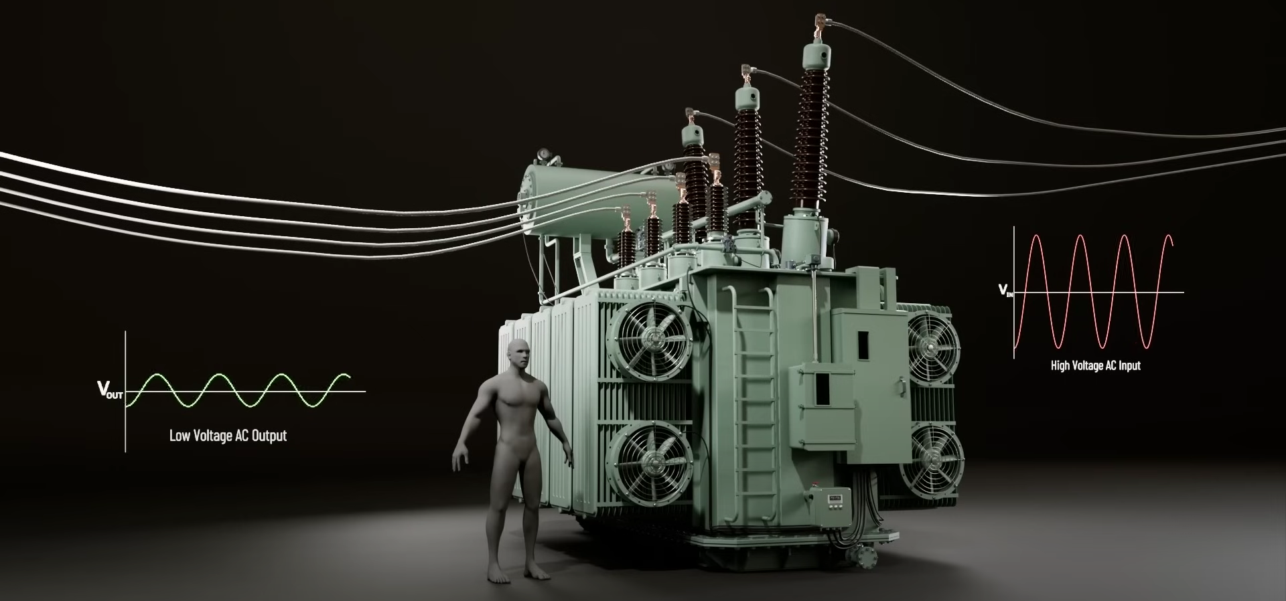

Power Transformer

Slide 2
Introduction
The invention of transformers in the late 19th century enabled modern AC power systems, allowing electricity to be sent from distant power stations to our homes with constant voltage.
This incredible machine operates at hundreds of thousands of volts and can handle millions of watt of electrical load.
Transformers are game changers in the field of electrical energy transmission and distribution.
It is a static machine which means unlike an electric motor.

Slide 3
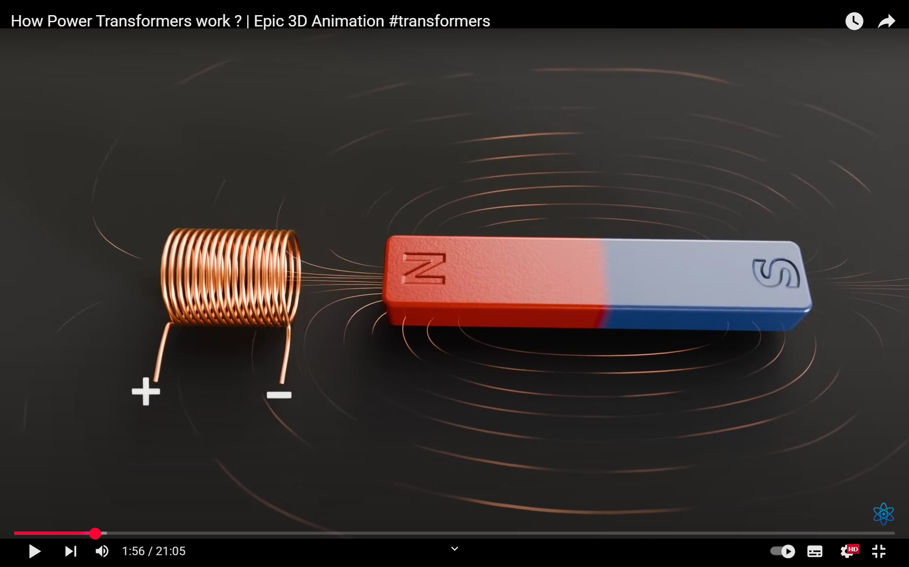
Transformer Basics
Transformer is used for increasing or decreasing the voltage levels of AC Supply.
It is one of the most efficient electrical machines.
A transformer works on Electromagnetic Induction, where a changing current in the primary coil creates a magnetic field that induces voltage in the secondary coil.

Slide 4
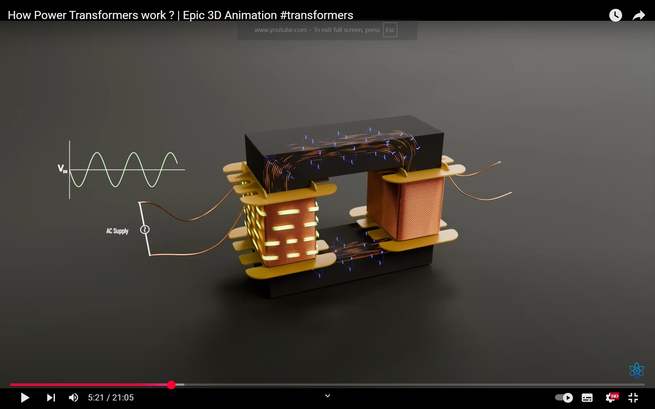
Strength of induced voltage depends upon the number of turns in the coil (N), Strength of Magnetic field (B) and rate of change of flux (ϕ)​ .
If DC Supply Connected, magnetic field produced is not changing with the time — hence, no voltage is induced.
The alternating flux passing through the core induces Loops of current inside the core (Eddy Current) cause energy loss which reduces the efficiency that's why laminated core is used .

Slide 5
Parts of Transformer
1. Core 4. Main Tank 7. Buchholz Relay
2. Winding 5. Conservator 8. Tap-Changer
3. Bushing 6. Fans 9. Radiator
10. Breather
TYPES OF TRANSFORMER :
a. Based on Core : b. Bases on Winding:
• Core Type • Step-Up (Np < Ns)
• Shell Type • Step-Down (Np > Ns)

Slide 6
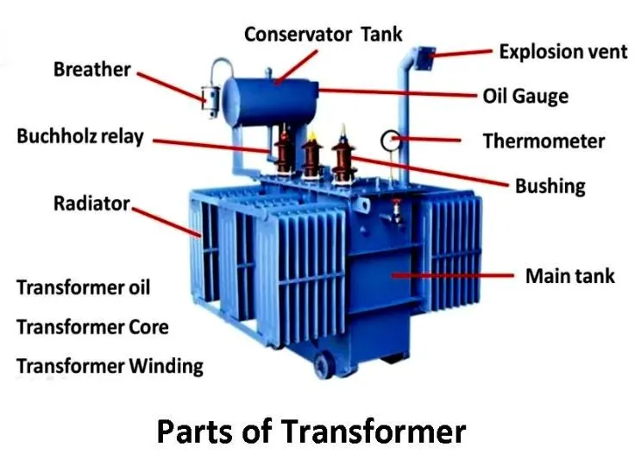

Slide 7
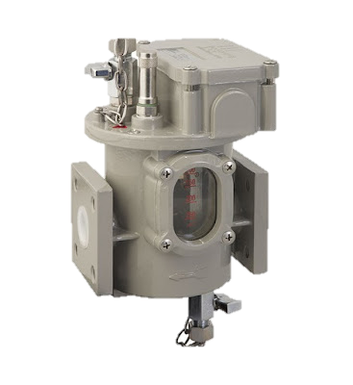
Core : Made of laminated steel to reduce energy loss. It carries magnetic flux between windings. Acts as a path for magnetic field.
Winding : Coils made of copper or aluminum wire. Primary takes input; secondary gives output. Creates and responds to magnetic flux.
Bushing : Insulated terminals for high-voltage connections. Connect internal windings to outside safely. Ensure reliable power flow in/out.
Buchholz Relay

Slide 8
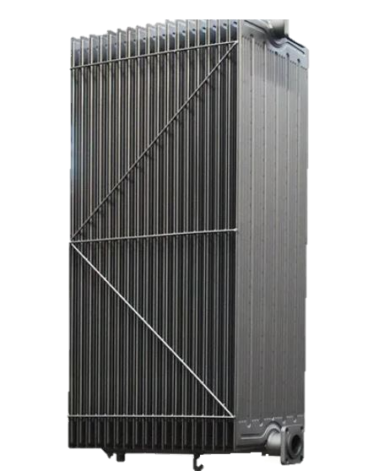
4. Main Tank :
Houses the core, windings, and oil. Provides mechanical protection to internal parts. Filled with insulating oil for cooling .
5. Conservator :
Stores extra oil and Balances oil level . Connected to the main tank via pipe. Prevents overpressure inside the tank.
6. Fans :
Installed near radiators for forced cooling. Blow air to reduce oil and core temperature. Help maintain safe working conditions.
Radiator

Slide 9
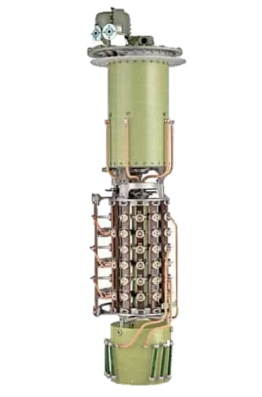
7. Radiator :
Used to cool hot transformer oil. Oil circulates through radiator fins. Heat is released into the air.
8. Tap - Changer :
Adjusts output voltage as needed. Alters turns in the winding coil. Can be manual or automatic.
9. Buchholz Relay :
Protective relay placed btw tank & conservator. Detects gas from internal faults or overheating. Triggers alarm or trips circuit breaker.
Tap-Changer

Slide 10
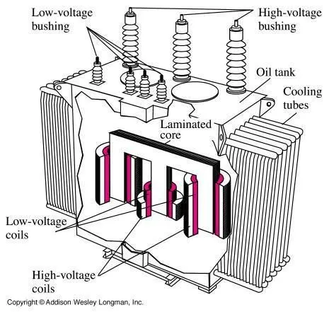
10. Breather
It is a cylindrical container filled with silica gel which absorbed the moisture as air passes from outside to Conservator tank .This is bcoz insulating oil reacts with moisture which can affect the insulation.

Slide 11
Special Thanks :
1. S.S Narula Sir
2. Kaushal Sir
Thank You

